Slide 1
QUIZ 3. DATA TRANSFER
GHANA MALARIA INDICATOR SURVEY, 2016

Slide 2
In a blank paper, please write:
Your FW code
Your name
Today’s date
Quiz 3

Slide 3
1. When interviewers transfer data to the supervisor, the transfer occurs as follows:
All interviewers send data at the same time to the supervisor
Interviewers send data one at a time to the supervisor
Both ways a and b are possible

Slide 4
2. When supervisors send assignments to interviewers:
a. All interviewers can receive the assignments at the same time
b. Interviewers receive the assignments one at a time
c. Both ways a and b are possible

Slide 5
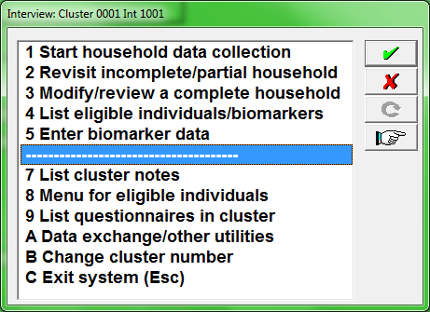
3. What is the correct way interviewers must exit the interviewer menu?

Slide 6
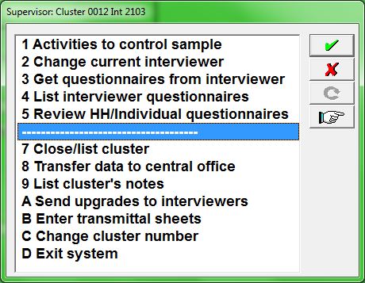
4. What is the correct way supervisors must exit the supervisor menu?

Slide 7
5. After completing the household interview, what option from the interviewer menu should be used/executed to accomplish next steps of data collection?

Slide 8
6. What is/are the purpose(s) for producing the report to “List eligible individuals/biomarkers”?
To know if the household data need to be shared with other team members.
To write down in the biomarker questionnaire all the information needed by the biomarker specialists to identify children for which biomarker samples are required.
To know the result of the woman’s interview.
A and b are correct.
A and c are correct.
B and c are correct.

Slide 9
7. What report should be used from the interviewer menu to view the status of each household visited by the interviewer?

Slide 10
8. The report “List questionnaires in cluster” is important because interviewers can see if the household/woman/biomarker have been completed or not yet visited; if completed, interviewers can see how many visits were needed before completing the interview, and how many biomarkers are completed out of the total number of eligible children in the household.
True
False

Slide 11
9. In the Ghana MIS 2016, data transfer among interviewers and supervisor occurs through:
USB flash drives
Bluetooth
SD cards
All of the above

Slide 12
10. When transferring data using Bluetooth, the transfer will work better when the tablets are relatively close to one another, what is the maximum distance allowed to transfer data through Bluetooth?
12 meters
9 meters
11 meters
10 meters

Slide 13
11. When transferring data to the supervisor, interviewers uses the following options from their menu:
A-Data exchange/other utilities
3-Receive HH data from other interviewer
1-Transfer cluster data to supervisor
6-Receive HH assignments from supervisors
A and b are correct
A and c are correct
A and d are correct

Slide 14
12. Upon arriving in a cluster, the supervisor should:
Locate a store and take a Coca-cola
Assign household to each interviewer in the team as well as him/herself
Transfer the household assignments to all members of the team using Bluetooth
A and b are correct
B an c are correct
A and c are correct

Slide 15
13. In order to receive assignments from the supervisor, interviewers uses the following options from the interviewer menu: Multiple answers
A-Data exchange/other utilities
3-Receive HH data from other interviewer
5-Receive system updates from supervisor
6-Receive HH assignments from supervisor

Slide 16
14. How often should interviewers send data to their supervisor:
____________________________________________

Slide 17
15. When is the best time for interviewers to send data to the supervisor?
Early in the morning of each working day
During mid-day
At the evening, when the work day is finished

Slide 18
16. Why is it important to transfer data to the supervisor in a regular basis?
a. To ensure a safeguard of the interviews on the machine of the supervisor if the machine of the interviewer breaks down, is lost, or stolen.
b. To provide the supervisor with the most recent information on the progress of the team work in the cluster. The supervisor is then able to determine which households and individuals are completed and what biomarkers are registered.
c. To allow the supervisor to review the received interviews, in order to check their quality and their completeness.
d. All of the above.

